Slide 1
Our Next Board: The Mixer
Looks Easy, But is Kind of Hard.
Get it Done.
Make Haste Slowly.

Slide 2
Recall what the Direct Conversion Receiver Does
It directly converts electro-magnetic radio signals that we can’t hear
into acoustic audio signals that we can hear.

Slide 3
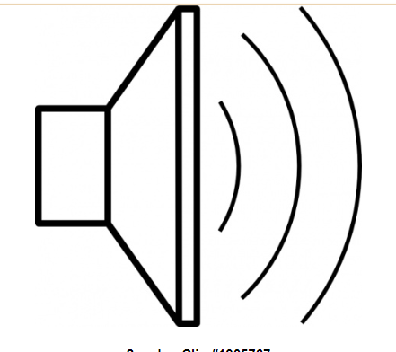
The Mixer Does this Direct Conversion
Bandpass
Filter
Mixer
Audio Amplifier
Oscillator
(VFO or PTO)

Slide 4
We take two signals…
-- One very weak from the antenna through the bandpass filter
-- The other, strong from the oscillator THAT YOU BUILT!
KEY POINT:
The mixer combines these two frequencies and produces SUM and DIFFERENCE outputs.

Slide 5
Antenna signal coming in at 7.001 MHz. Your oscillator is set to 7.000 MHz.
The Sum frequency: 14.001 MHz (we can’t hear that)
The Difference frequency .001 MHz (or 1 kHz) (we CAN hear that!)
So we take the difference frequency, we amplify it, and listen to it!
We discard the sum frequency.
THAT’S THE ESSENCE OF MIXING. THAT’S WHAT THE RECEIVER DOES.

Slide 6
How does it do that?
Joseph Fourier: Any complex repeating wave form is composed of many sine waves.
2) Among these are sum and difference frequencies.
3) Our mixer produces a complex repeating wave form.
4) And in this complex repeating wave form there are the sum and difference frequencies.

Slide 7
For more on exactly how this mixer works
In this blogpost and YouTube video, I explain how our diode mixer works.
https://soldersmoke.blogspot.com/2022/10/how-diode-ring-multiplies-by-1-and-1.html
Someday a math teacher will get into Fourier. You will have already built a device that uses his discovery.

Slide 8
Here is the Mixer Schematic

Slide 9
Building the Mixer – First: Put down the pads.

Slide 10
Next – Wire in the Four Diodes. Watch the polarity! Cathode to Anode all around!

Slide 12
We will use mixer transformers from Farhan VU2ESE in Hyderabad, India
Farhan gave them to me during a visit to the U.S.
They were made by seamstresses in Hyderabad, India (Farhan was helping them by giving them additional work).
Using parts supplied by friends adds soul to your new machines!
Farhan will visit in May.

Slide 13
Next, get your two transformers. You will get them like this:

Slide 14
Here are the wires:

Slide 15
Watch out for shorts underneath!

Slide 17
Wire in the transformers: RF side first.
RF Transformer (Black)
Soldered center tap to ground (BLACK TAP)
Now untwist the twisted pair.One to ground the other to Black T1 pad
The two remaining wires go to Black T2 and B3 on the diamond.
LO Transformer (Red)
Solder center tap to Red Tao pad.
Now untwist the twisted pair. One to ground the other to Red T1 pad
The two remaining wires go to Red B3 and T2 on the diamond.

Slide 18
Check the circuit for proper wiring and the avoidance of accidental shorts.
Time to test!
We will put an signals in RF at 7.001 Mhz and VFO at 7.000 and we will see if audio 1000 Hz audio comes out. It should!

Slide 19
YS1YXI - Mily – She is the Youngest Ham in El Salvador
I spoke to her on the radio last week.
She is deeply into ham radio satellites!
More info on her here:
https://www.qrz.com/DB/YS1YXI
She would be interested in your club.
You can e-mail her here:
ys1yxi@gmail.com

